Slide 1
Azure Repos
Ow

Slide 2
What is a CICD pipeline?
Continuous integration (CI) is the practice used by development teams to simplify the testing and building of code. CI helps to catch bugs or problems early in the development cycle, which makes them easier and faster to fix.
Continuous delivery (CD) is a process by which code is built, tested, and deployed to one or more test and production stages. Deploying and testing in multiple stages helps drive quality.
CI/CD bridges the gaps between development and operation activities and teams by enforcing automation in building, testing, and deployment of applications.

Slide 3
Feature Set
A CICD pipeline can consist of multiple components.
A pipeline defines the continuous integration and deployment process for your app. It can be thought of as a workflow that defines how your test, build, and deployment steps are run.
Stages, jobs, and steps are the main building blocks of a Pipeline. A stage can consist of one or more jobs, and a job can consist of one or more steps. A step is the smallest building block of a pipeline to perform an action, that can be a task or script.
When a pipeline gets executed is controlled by the Trigger. A pipeline can be configured to run upon a push to a repository, at scheduled times, or upon the completion of another build. All of these actions are known as triggers.

Slide 4
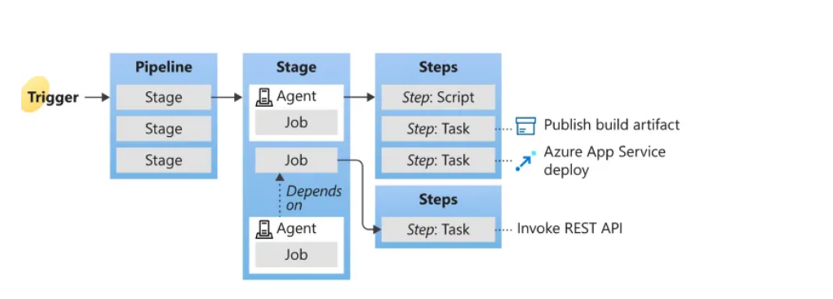
Agent
To start the CICD pipeline, at least one agent is required. An agent is a computing infrastructure with installed agent software that runs one job at a time. Azure DevOps provides Microsoft-hosted agents that waives the setup and maintenance effort for users

Slide 5
Azure pipeline
There are multiple ways of setting up the CICD pipeline on Azure DevOps. In this introduction, we will start from a simple one via YAML definition.
Basic Requirements
An Azure DevOps account
Git
YAML
Initial Setup
Create an empty repo named TemplateRepo
Inside the repo, create an empty YAML file named azure-pipeline.yml and copy-paste the following lines into that file.
Commit this file to the remote repo on master branch.

Slide 6
..
# Repo: MySpace/TemplateRepo
# File: azure-pipeline.yml
name: cicd_ci
trigger:
branches:
include:
- master
stages:
- stage: CI_Checks
jobs:
- job:
displayName: yamllint_checks
pool:
vmImage: 'ubuntu-latest'
steps:
- script: |
python -m pip install --upgrade pip
pip install yamllint
yamllint -d "{extends: relaxed, rules: {line-length: {max: 200}, new-line-at-end-of-file: disable, new-lines: disable}}" .
displayName: 'YAML Lint Checks'

Slide 7
Explanation
name: the pipeline name in a string as cicd_ci
trigger: branch name master will trigger a build
stages: there is one stage named as CI_Checks , within this stage, there is one job with a friendly given name yamllint_checks . The job runs by the Microsoft-hosted agent uses VM image ubuntu-latest
script: a shortcut for command-line task, the script consists of 3 commands as listed, and the command will be running in order. The command can be replaced with other working commands.

Slide 8
..
Now, we can create a new pipeline using this YAML definition. Go to your DevOps, on the left panel, Pipelines -> Pipelines -> New pipeline (a button on top right corner), then you will enter the page below. Depends on where your YAML file is located, you can choose where to import it:

